Slide 1
Team Lead 3 Presentation
Hayden, Riley, Heath, Zach

Slide 2
Presentation Overview
Introduction
What is testing?
Why do we test?
Verification Vs Validation
Release Testing
User Testing
Agile Methods
Design Patterns
What are Design Patterns
Creational Patterns
Structural Patterns
Behavioral Patterns
AntiPatterns
Arguments against using Patterns
Requirements for this Class
Useful Resources
Examples
Intro to tests + Boundary tests
EditMode Tests vs PlayMode Tests
How to set up testing
Creating boundary tests
Running tests
Stress tests
Stress Test Development Demo
How to interpret Results
Play mode or edit mode??

Slide 3
What is Testing?
Testing software is just running a program with artificial data.
Tests are intended show that a program does what it is intended to do and to discover defects before it is put into use.
Tests can reveal the presence of errors in your code not the absence.
Tests are apart of a general validation process

Slide 4
Why do we need automated testing?
3 Big reasons:
Ensure your program can hold up to various inputs
Communicate to your team whether your code is functional
Find the limit of your program in order to stay inside of it

Slide 5
Why do we need automated testing? Continued
Testing Goals:
To Discover situations in which the behaviour of the software is incorrect, undesirable, or not to specification. (defect testing)
To Demonstrate to the customer and developer that the software meets its requirements. (validation testing)

Slide 6
Verification Vs Validation
Verification: “Are we building the product right”
The software should conform to its specifications
Validation: “Are we building the right product”
The software should do what the user needs it to do

Slide 7

Release Testing

Slide 8
Release Testing
Release testing is the process of testing a particular release of a system that is intended for use outside of the dev team
The primary Goal of this testing is to convince the supplier of the system that it is good enough for use.
Thus it has to show the system is dependable, functional, and can perform without fail in normal use

Slide 9
Use Case Testing
Use cases are developed in order to mimic the use of the software as if the user were using it, to help develop test cases for the software.
Example: Login Page
Enter Login credentials
Validate credentials
Give access to User

Slide 10
Requirements based Testing
Requirements Testing involves examining the requirements of the system and developing tests or a test for it
Example: Login Page
-Give access to Password/Username is right
-Reject access if Password/Username is wrong
-limit amount of wrong attempts

Slide 11
Performance Testing
Part of release testing may involve looking at the performance of the system
Tests should reflect the profile of use of the system
Performance tests involves steadily increasing load until performance becomes unacceptable
Stress Tests != Performance Tests

Slide 12

User Testing

Slide 13
User Testing
User testing is a stage in the testing process where the user or customer can provide input on system testing.
User Testing is essential, even when release and system testing have been carried out. The users working environment is essential when tailoring software for performance, usability, and reliability.

Slide 14
Types of User Testing
Alpha Testing
A User works with a development team to test the software at the developers site.
Beta Testing
A release of software is made available to gather feedback.
Acceptance Testing
Customers test a system to determine whether or not it is ready to be accepted and deployed.

Slide 15
Steps in acceptance testing process
Define acceptance criteria
Plan acceptance testing
Derive acceptance tests
Run acceptance tests
Negotiate test results
Reject/accept system

Slide 16
Agile Methods and acceptance testing
In agile methods, the user is part of the dev team and is responsible for making decisions on the acceptability of the system.
Tests are defined by the user/customer and integrated into other tests that are run automatically when changes are made
There is no separate acceptance testing process
Main Problem here is whether or not the customer can represent the typical user

Slide 17
What is required of you?
Initial Test Plan (Thursday)
1 Stress Test
2 Boundary Tests
Full test Plan (Oral Exam)
2 Patterns somewhere in your code (Oral Exam)
Justify the pattern you Choose, talk about where you would not use it

Slide 18
End Section
Questions?

Slide 19
Design Patterns

Slide 20
Design Patterns
Repeatable solutions to common problems
Not meant for direct implementation
Helps communication

Slide 21
Design Patterns
Creational
Structural
Behavioral
AntiPatterns

Slide 22
Creational Patterns
Patterns that deal mainly with how objects are created
Abstract Factory
Builder
Factory Method
Object Pool
Prototype
Singleton

Slide 23
Structural Patterns
Simplifies design by recognizing the relationships between objects
Adapter
Bridge
Composite
Decorator
Facade
Flyweight
Private Class Data
Proxy

Slide 24
Behavioral Patterns
Patterns that allow communication between objects to operate more efficiently
Chain of Responsibility
Command
Interpreter
Iterator
Mediator
Memento
Null Object
Observer
State
Strategy
Template Method
Visitor

Slide 25
Anti-Patterns
Common design processes that are known to be defective and can be simplified using design patterns
The Blob
Continuous Obsolescence
Lava Flow
Ambiguous Viewpoint
Functional Decomposition
Poltergeists
Boat Anchor
Golden Hammer
Dead End
Spaghetti Code
Input Kludge
Walking through a Minefield
Cut-and-Paste Programming
Mushroom Management

Slide 26
Arguments Against Design Patterns
The need for patterns results from a lack of abstraction in programing languages
Patterns are not meant to be copied
Leads to non-optimal solutions

Slide 27
Course Requirements (oral exam)
2 patterns implemented in each person’s code
Know why you used the specific pattern
Be capable of recreating the class diagram of the pattern

Slide 28
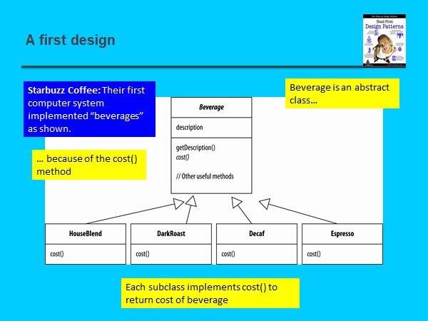
Decorator
Goal is to encapsulate what varies
Program interfaces without direct implementations

Slide 29
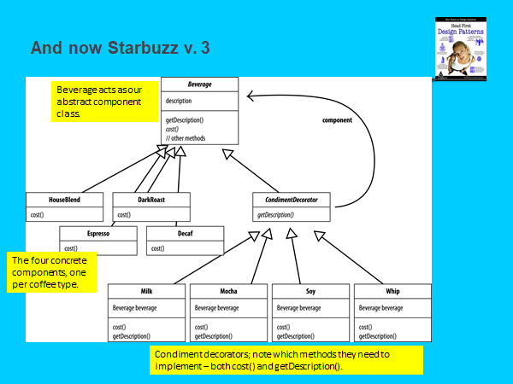
Decorator
Decorators wrap objects in order to add additional behavior to them
An alternative to inheritance
Components can have multiple decorators

Slide 30
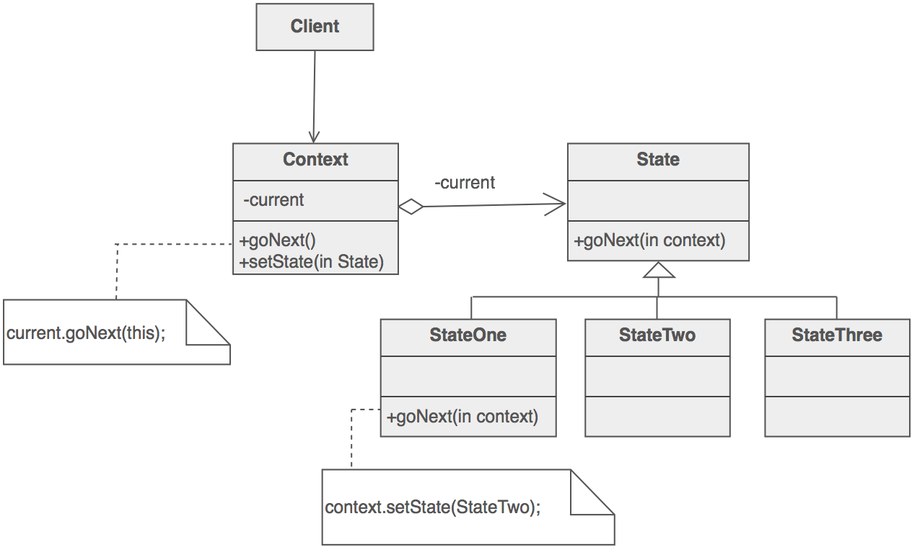
State
Define an abstract base state class
Represent different states in classes derived from the abstract state class that derive specific behavior

Slide 31
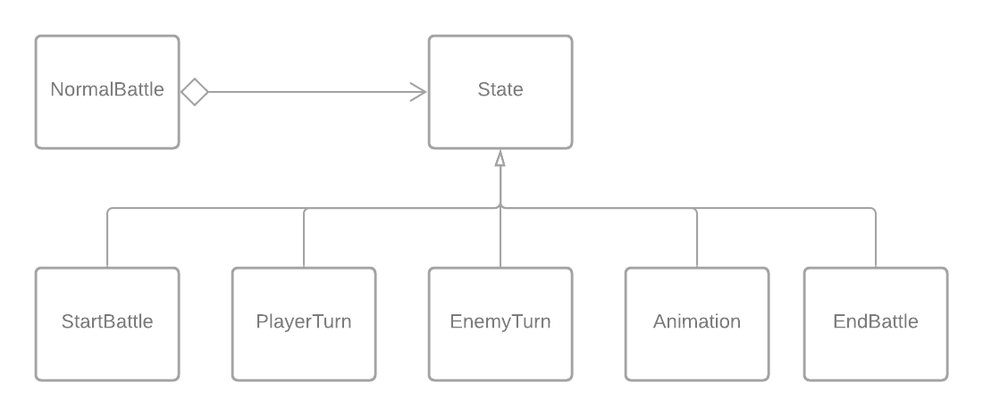
State
Allows functionality to change along with the state
Identical structure to bridge but solves different problems

Slide 32
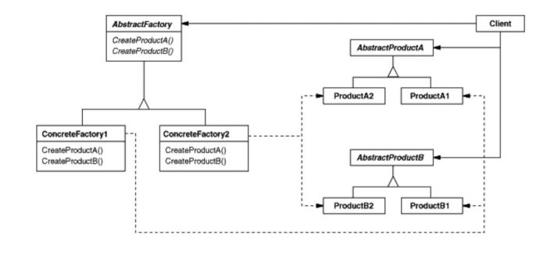
Abstract Factory
Useful for creating objects of multiple types
Object type is abstracted from user

Slide 33
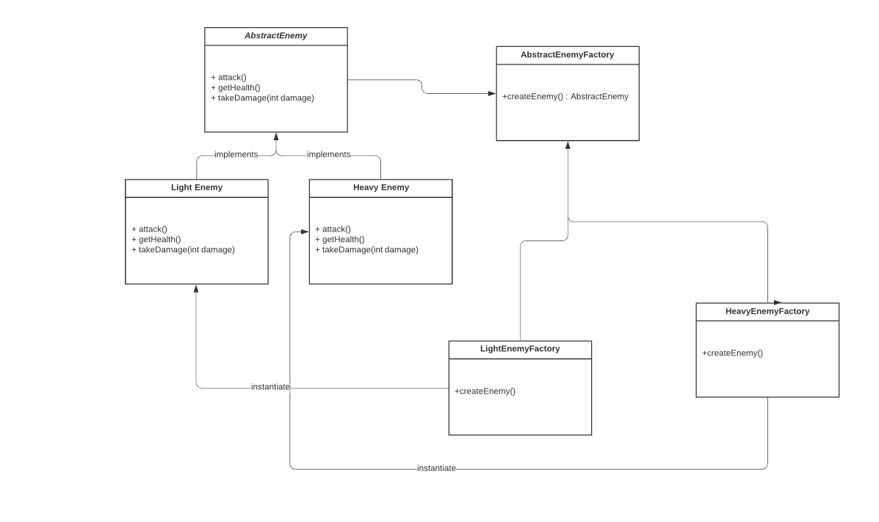
My Example of an Abstract Factory

Slide 34
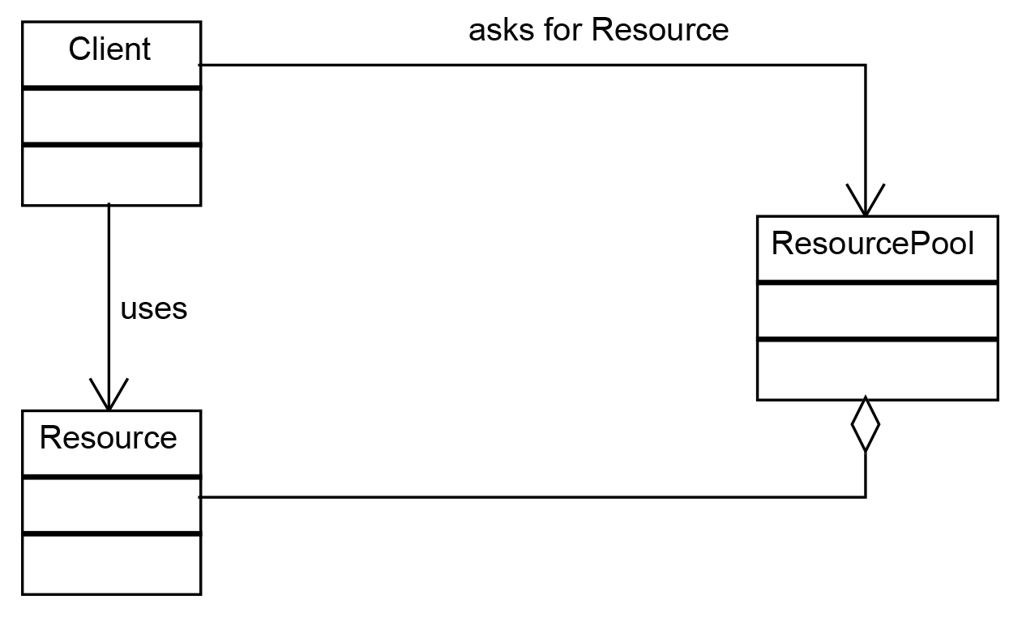
Example of Object Pool
Used for recycling objects
When to use:
Frequent object instantiation
Object’s usage is minimal
Object Instantiation is costly
Ex. Spawners
https://subscription.packtpub.com/book/application_development/9781786463593/2/ch02lvl1sec23/object-pool-pattern

Slide 35
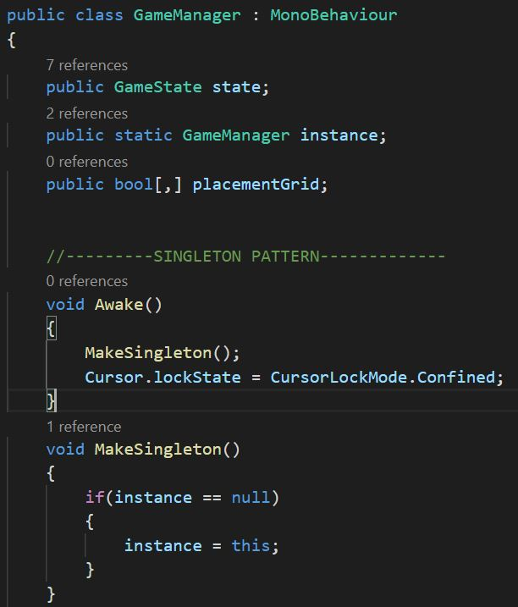
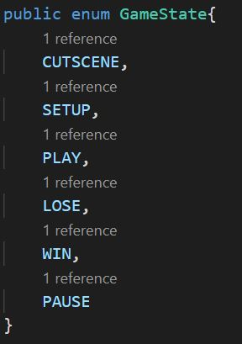
Singleton: Game Manager

Slide 36
Resources
https://sourcemaking.com/design_patterns
Also available under “useful links” on Dr. Bc’s website
Design Patterns

Slide 37
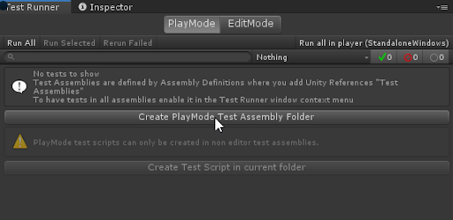
Edit Mode tests vs Play Mode tests
Edit Mode
For any code that does not need the game to be ran to be tested
Nothing should inherit from MonoBehaviour
Play Mode
My preferred option
Able to actually load a scene
Can test anything
More powerful

Slide 38
What is a boundary test?
Any test where you are checking if a value is in a certain range
Example: Player health
Player health should be in [0,100]

Slide 39
Our How to doc
https://docs.google.com/document/d/1tHVF3wdHjWnRsRIUK07EPtFTcwzeqWEIfSI-SfFEzyI/edit?usp=sharing

Slide 40
DEMO

Slide 41
What is a Stress Test?

Slide 42
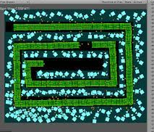
What is a Stress Test
A stress test is any test applies stress incrementally until the code breaks
Examples:
Object Instantiation
Velocity Expansion
Failure Examples:
Collision Detection Failure
Frame Rate Reduction
https://www.deadlyapps.com/2011/09/unity-td-stress-test.htm

Slide 43
DEMO

